Slide 1
Object Oriented Programming

Slide 2
Introduction to Programming

Slide 3
Introduction to Data types
Introduction to Data types
Primitive types (integer, string, floating-point, boolean character etc..)
Composite types (class, structure etc..)

Slide 4
Operators and Expressions
Operator is an operation performed over data at run time.Operator has precedence
Type of operators
Arithmetic Operators ( + - * / % ++ -- )
Logical Operators ($$ || ^ !)
Bitwise Operators ($ | ^ ~ << >>)
Comparison Operators (== != < > <= >=)
Assignment Operators (= += -= *= /= etc..)
Other Operators (. [] () ?: new )

Slide 5
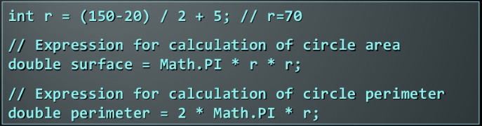
Operators and Expressions (2)
Expressions are sequence of operators and operands that are evaluated to a single value
Example

Slide 6
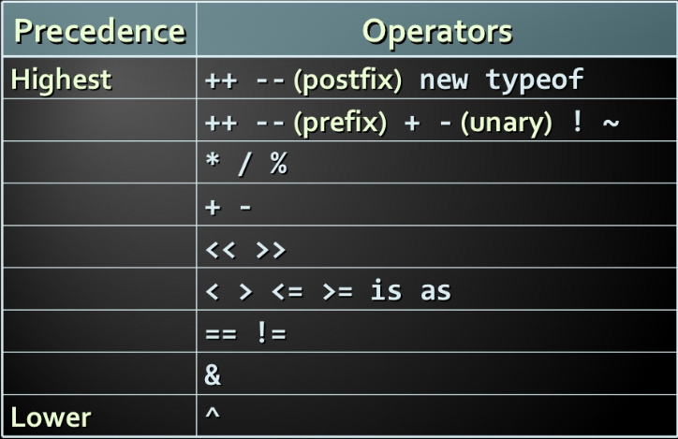
Precedence of operators

Slide 7
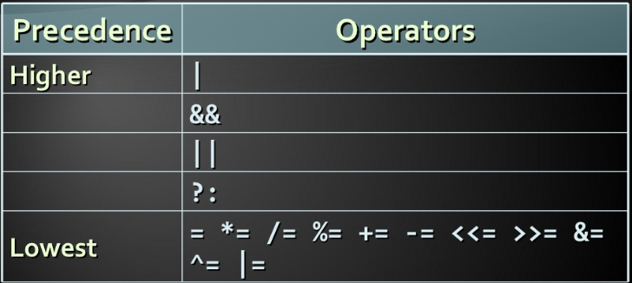
Precedence of operators (2)
Parenthesis operator always has highest precedence
Prefer using parentheses, even when it seems stupid to do so

Slide 8
Conditional Statements
If and if else
Switch - case

Slide 9
Loops
While loops
do…while loops
for loops
for each loops

Slide 10
Arrays

Slide 11
Methods

Slide 12
Object-Oriented Programming
Suyati Technology
Notes:
(c) 2006 National Academy for Software Development - http://academy.devbg.org*
12##

Slide 13
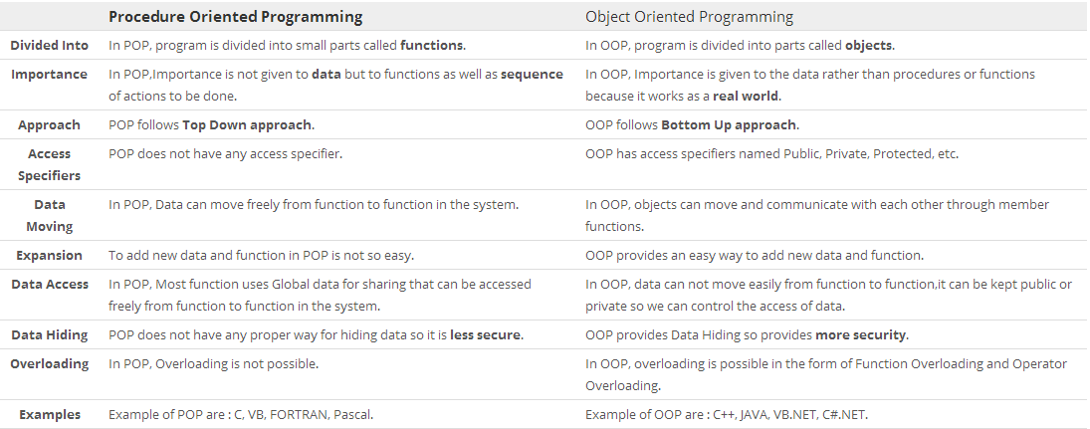
OOPS Vs Procedural Programming

Slide 14
Advantages of OOPS
Modularity
Code Re-usability
Information hiding
Easy Debugging

Slide 15

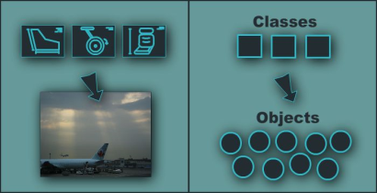
Introduction to Class and Object
Notes:
(c) 2006 National Academy for Software Development - http://academy.devbg.org*
15##

Slide 16
Classes and Objects
Classes define attributes and behavior
Fields, properties, methods, etc.
Methods contain code for execution
Object is an instance of a class
Objects has state(data) and behavior(function)
public class Student { … }
Student std = new Student();

Slide 17
Objects
An object is a concrete instance of a particular class
Creating an object from a class is called instantiation
Objects have state
Set of values associated to their attributes

Slide 18
Classes
Basic units that compose programs
Implementation is encapsulated (hidden)
Classes in C# can contain:
Fields (member variables)
Properties
Methods
Constructors
Inner types
Etc. (events, indexers, operators, …)

Slide 19
Fields and Properties

Slide 20
Fields
Fields are data members of a class
Can be variables and constants
Accessing a field doesn’t invoke any actions of the object
Constant fields can be only read
Variable fields can be read and modified

Slide 21
Properties
Properties look like fields (have name and type), but they can contain code, executed when they are accessed
Usually used to control access to data fields (wrappers), but can contain more complex logic
Can have two components (and at least one of them) called accessors
get for reading their value
set for changing their value

Slide 22
Properties (2)
According to the implemented accessors properties can be:
Read-only (get accessor only)
Read and write (both get and set accessors)
Write-only (set accessor only)

Slide 23
Instance and Static Members
Fields, properties and methods can be:
Instance (or object members)
Static (or class members)
Instance members are specific for each object
Example: different persons have different name
Static members are common for all instances of a class
Example: DateTime.MinValue is shared between all instances of DateTime

Slide 24
Accessing Members – Syntax
Accessing instance members
The name of the instance, followed by the name of the member (field or property), separated by dot (".")
Accessing static members
The name of the class, followed by the name of the member
<instance_name>.<member_name>
<class_name>.<member_name>

Slide 25
Methods
Methods manipulate the data of the object to which they belong or perform other tasks
Examples:
Console.WriteLine(…)
Console.ReadLine()
String.Substring(index, length)
Array.GetLength(index)

Slide 26
Instance Methods
Instance methods manipulate the data of a specified object or perform any other tasks
If a value is returned, it depends on the particular class instance
Syntax:
The name of the instance, followed by the name of the method, separated by dot
<object_name>.<method_name>(<parameters>)

Slide 27
Static Methods
Static methods are common for all instances of a class (shared between all instances)
Returned value depends only on the passed parameters
No particular class instance is available
Syntax:
The name of the class, followed by the name of the method, separated by dot
<class_name>.<method_name>(<parameters>)

Slide 28
Constructor & Destructor

Slide 29
Constructor
Constructors are special methods used to assign initial values of the fields in an object
Executed when an object of a given type is being created
Have the same name as the class that holds them
Do not return a value
A class may have several constructors with different set of parameters
Constructor is invoked by the new operator

Slide 30
Types of Constructors
Default Constructor
Parameterized Constructor
Copy Constructor
Static Constructor
Private Constructor

Slide 31
Destructor
Destructors are used to destruct instances of classes.
A class can only have one destructor.
Destructors cannot be called. They are invoked automatically.
A destructor does not take modifiers or have parameters.

Slide 32
Destructor (2)
Example:
class Car {
~Car() // destructor
{
// cleanup statements...
}
}

Slide 33
Accessibility Levels
Access modifiers in C#
public – access is not restricted
private – access is restricted to the containing type
protected – access is limited to the containing type and types derived from it
internal – access is limited to the current assembly
protected internal – access is limited to the current assembly or types derived from the containing class

Slide 34
Namespaces
Namespaces are used to organize the source code into more logical and manageable way
Namespaces can contain
Definitions of classes, structures, interfaces and other types and other namespaces
Namespaces can contain other namespaces

Slide 35
Full Class Names
A full name of a class is the name of the class preceded by the name of its namespace
Example:
Array class, defined in the System namespace
The full name of the class is System.Array
<namespace_name>.<class_name>

Slide 36
Including Namespaces
The using directive in C#:
Allows using types in a namespace, without specifying their full name
Example:
instead of
using <namespace_name>
using System;
DateTime date;
System.DateTime date;

Slide 37
Message and Methods
Messages are instruction to a class or an object to perform a task.
The class or object should posses a matching Method to handle the messages
Value pass to an object when sending a message is called argument.
Objects talk to each other via Messages.

Slide 38
Encapsulation
Encapsulation is the integration of data and the operations into a class.
Encapsulation hides the functional details from the object calling it.

Slide 39

Association Aggregation and Composition
Association is a relationship between two objects. In other words, association defines the multiplicity between objects.
Types of Association
one-to-one
one-to-many
many-to-one

Slide 40
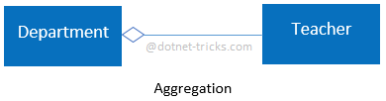
Association Aggregation and Composition (2)
Aggregation is a specialized form of Association where all object have their own lifecycle but there is ownership.
Example : Relationship between Department and Teacher. A Teacher may belongs to multiple departments. Hence Teacher is a part of multiple departments. But if we delete a Department, Teacher Object will not destroy

Slide 41
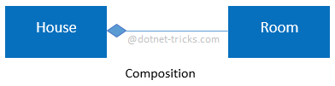
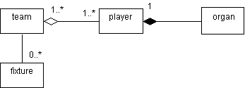
Association Aggregation Composition (3)
Composition is a specialized form of Aggregation. It is a strong type of Aggregation. In this relationship (“Has-a”) child objects does not have their lifecycle without Parent object. If a parent object is deleted, all its child objects will also be deleted.
Example for Association Aggregation and Composition

Slide 42
Inheritance
Inheritance is a mechanism of acquiring the features and behaviors of a class by another class.
The class whose members are inherited is called the base class, and the class that inherits those members is called the derived class.
Inheritance implements the “IS-A “ relationship (Association).

Slide 43
Inheritance (2)
Types of inheritance
Single Inheritance
Multilevel Inheritance
Multiple Inheritance (Not supported in c#)
Hierarchical Inheritance
Hybrid Inheritance (Not supported in c#)

Slide 44
Composition / Inheritance?
One has to have proper reason to use composition/inheritance
Tips:
Prefer Composition when not sure about Inheritance
Prefer Composition when not all the super class functions where re-used by sub class
Inheritance leads to tight coupling between the classes
Composition makes the code maintainable

Slide 45
Polymorphism
Polymorphism means “Many forms”
Example : public int AddNumbers(int a, int b) {} public int AddNumbers(int a, int b, int c){}
Types of Polymorphism
Compile time polymorphism
(Called as Early Binding or Overloading or static binding)
Runtime polymorphism
(Called as Late Binding or Overriding or dynamic binding)

Slide 46
Abstraction
Abstraction refers to showing only the necessary details to the intended user. As the name suggests, abstraction is the "abstract form of anything".
Abstraction in programming languages is used to make abstract class. Abstract class represents abstract view of methods and properties of class.

Slide 47
Abstract Class
The abstract keyword enables you to create classes and class members that are incomplete and must be implemented in a derived class.
An abstract class cannot be instantiated. The purpose of an abstract class is to provide a common definition of a base class that multiple derived classes can share.
An Abstract class can have abstract methods

Slide 48
Sealed Class
The sealed keyword (C#, final in java) enables you to prevent the inheritance of a class or certain class members that were previously marked virtual.
Sealed class cannot also be an abstract class.
Sealed class members slightly faster.

Slide 49
Interfaces
An interface is a contract consisting of a related function prototypes whose usage is defined but whose implementation is not
An interface looks like a class, but has no implementation. The only thing
It contains only declarations of events, methods, properties or indexers .
A class or struct that implements the interface must implement the members of the interface that are specified in the interface definition.

Slide 50
Interfaces (2)
Defining an Interface
interface IMyInterface{ void myMethod (); }
Using an interface
class myClass : IMyInterface { public void myMethod () { } }

Slide 51
Coupling
Coupling defines how depend one object on another object
Coupling is a measure of strength of connection between any two system components.
The more any components knows about other components – coupling is tighter (worse design)

Slide 52
Cohesion
Cohesion is the extent to which two or more parts of a system are related and how they work together to create something more valuable than the individual parts.
Low coupling and tight cohesion is good Object Oriented Design (OOD)

Slide 53
Principles of class design
Single Responsibility Principle (SRP)
Open Close Principle (OCP)
Liskov Substitution Principle (LSP)
Dependency inversion Principle (DIP)
Interface segregation Principle (ISP)

Slide 54
Single responsibility principle
Each responsibility should be a separate class, because each responsibility is an axis of change.
A class can have one and only one reason to change.

Slide 55
Open Close Principle
Software entities (classes, modules, functions, etc.) should be open for extensions but closed for modification
In other words (in an ideal world) you should never change an existing code or class: All new functionality can be added by using subclasses or methods or by reusing the existing code

Slide 56
Liskov Substitution Principle
Derived types must be completely substitutable for their base types
This principle is just an extension of the Open Close Principle and it means that we must make sure that new derived classes are extending the base classes without changing their behavior.

Slide 57
Dependency Inversion
High level modules should not depend to low level modules, both should be depend upon abstractions.
Abstractions should not depend on details. Details should depends upon abstractions
A bad design means;
Rigid (Hard to change due to dependencies on )
Fragile (Changes cause unexpected bugs)
Immobile (difficult to reuse due to implicit dependence on current application code)

Slide 58
Interface Segregation
Clients should not forced to methods that they do not use.
ISP says that once an interface become too fat it need to split in to smaller and more specific interfaces

Slide 59
Object-Oriented Programming Basic Concepts
?
Questions?
?
?
?
?
?
?

Slide 60
THANKS

